Slide 1



Pitfalls in Online Controlled Experiments Slides at https://bit.ly/CODE2016Kohavi
Ron Kohavi, Distinguished Engineer, General Manager, Analysis and Experimentation, Microsoft
See http://bit.ly/expPitfalls for earlier work on pitfalls
Thanks to Brian Frasca, Alex Deng, Paul Raff, Toby Walker from A&E, and Stefan Thomke
Notes:
Trustworthy Results: Pitfalls in Online Controlled Experiments
Abstract:
It's easy to run a controlled experiment and compute a p-value with five digits after the decimal point. While getting such precise numbers is easy, getting numbers you can trust is much harder. We share practical pitfalls from online controlled experiments across multiple groups at Microsoft.

Slide 2

About the Team
Analysis and Experimentation team at Microsoft:
Mission: Accelerate innovation through trustworthy analysis and experimentation. Empower the HiPPO (Highest Paid Person’s Opinion) with data
About 80 people
40 developers: build the Experimentation Platform and Analysis Tools
30 data scientists
8 Program Managers
2 overhead (me, admin).
Team includes people who worked at Amazon, Facebook, Google, LinkedIn
Notes:
Video shows scorecard at https://www.youtube.com/watch?v=SiPtRjiCe4U&t=105

Slide 3
The Experimentation Platform
Experimentation Platform provides full experiment-lifecycle management
Experimenter sets up experiment (several design templates) and hits “Start”
Pre-experiment “gates” have to pass (specific to team, such as perf test, basic correctness)
System finds a good split to control/treatment (“seedfinder”). Tries hundreds of splits, evaluates them on last week of data, picks the best
System initiates experiment at low percentage and/or at a single Data Center. Computes near-real-time “cheap” metric and aborts in 15 minutes if there is a problem
System wait for several hours and computes more metrics. If guardrails are crossed, auto shut down; otherwise, ramps-up to desired percentage (e.g., 10-20% of users)
After a day, system computes many more metrics (e.g., thousand+) and sends e-mail alerts about interesting movements (e.g., time-to-success on browser-X is down D%)
Notes:
Video shows scorecard at https://www.youtube.com/watch?v=SiPtRjiCe4U&t=105

Slide 4
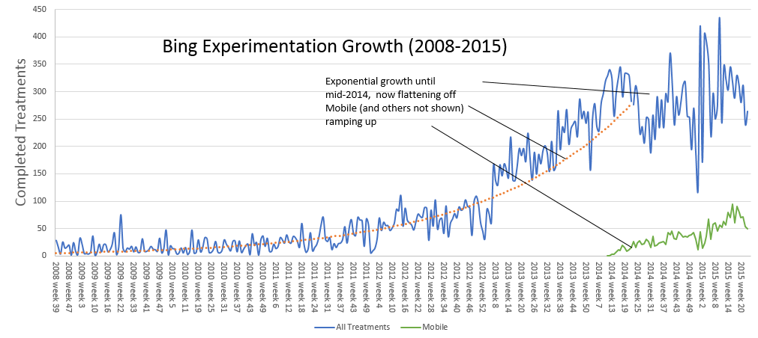
Scale
We finish about ~300 experiment treatments per week, mostly on Bing, MSN, but also on Office (client and online), OneNote, Xbox, Cortana, Skype, and Exchange. (These are “real” useful treatments, not 3x10x10 MVT = 300.)
Typical treatment is exposed to millions of users, sometimes tens of millions.
There is no single Bing. Since a user is exposed to over 15 concurrent experiments, they get one of 5^15 = 30 billion variants (debugging takes a new meaning)
Until 2014, the system was limiting usage as it scaled. Now limits come from engineers’ ability to code new ideas
Notes:
Video shows scorecard at https://www.youtube.com/watch?v=SiPtRjiCe4U&t=105

Slide 5
Pitfall 1: Failing to agree on a good Overall Evaluation Criterion (OEC)
The biggest issues with teams that start to experiment is making sure they
Agree what they are optimizing for
Agree on measurable short-term metrics that predict the long-term value (and hard to game)
Microsoft support example with time on site
Bing example
Bing optimizes for long-term query share (% of queries in market) and long-term revenue. Short term it’s easy to make money by showing more ads, but we know it increases abandonment. Revenue is a constraint optimization problem: given an agreed avg pixels/query, optimize revenue
Queries/user may seem like a good metric, but degrading results will cause users to search more. Sessions/user is a much better metric (see http://bit.ly/expPuzzling). Bing modifies its OEC every year as our understanding improves. We still don’t have a good way to measure “instant answers,” where users don’t click
Notes:
You can fill the page with ads, which is what happened with the early search engines

Slide 6
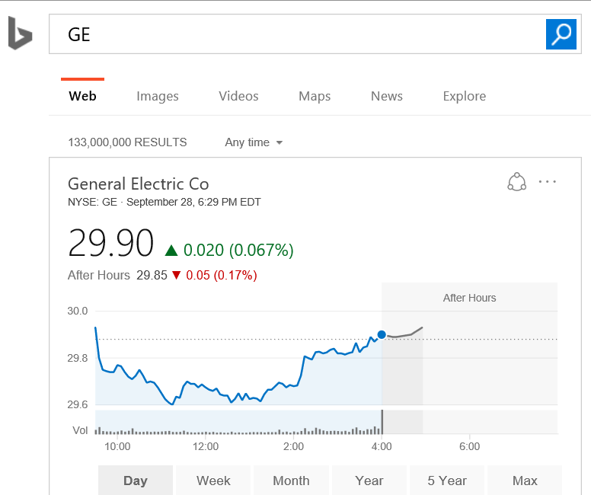
Pitfall 1 continued
We still don’t have a good metric for the value of instant answers (knowledge graph) where users don’t need to click. Was the answer great, or did the users abandon?
Example: query “GE” gives the stock information. If users don’t click, their intent was likely satisfied

Slide 7
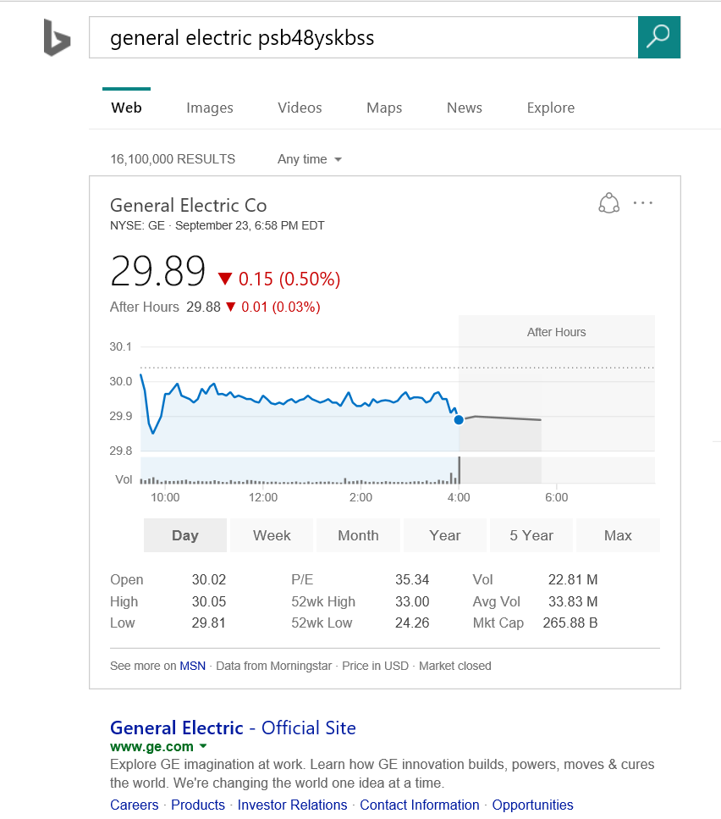
Pitfall 1 continued
But if the query is “general electric psb48yskbss” as I did for my refrigerator when I looked for its manual, then the answer was poor (and so was the rest of the page) so I abandoned
Hard to tell the difference between satisfied users and abandoning users when there is no click
Problem is easier on mobile because users scroll to see rest of page, so scrolling down without a click is a sign of abandonment

Slide 8

Bad OEC Example
Your data scientists makes an observation: 2% of queries end up with “No results.”
Manager: must reduce. Assigns a team to minimize “no results” metric
Metric improves, but results for query brochure paper are crap (or in this case, paper to clean crap)
Sometimes it *is* better to show “No Results.” This is a good example of gaming the OEC.
Real example from my Amazon Prime now search 3/26/2016 https://twitter.com/ronnyk/status/713949552823263234
Notes:
@@Dev: if you’re wrong, it’s often clear: crashes.
Here: if the OEC is wrong, it’s hard to tell. MetricsLab, degradation flights. Tufte’s talk. Human behavior is not rocket science, it’s harder.
Point to Alex’s paper

Slide 9
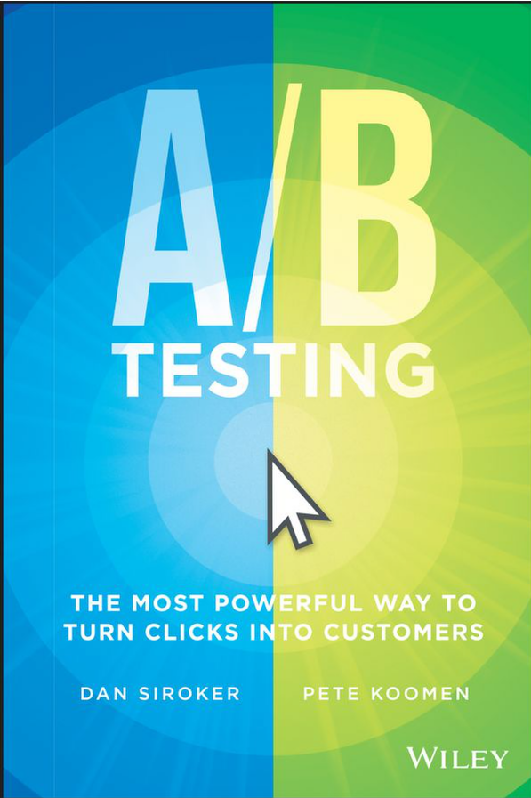

Pitfall 2: Failing to Validate the Experimentation System
Software that shows p-values with many digits of precision leads users to trust it, but the statistics or implementation behind it could be buggy
Getting numbers is easy; getting numbers you can trust is hard
Example: Two very good books on A/B testing get the stats wrong (see Amazon reviews)
Our recommendation:
Run A/A tests: if the system is operating correctly, the system should find a stat-sig difference only about 5% of the time
Do a Sample-Ratio-Mismatch test. Example
Design calls for equal percentages to Control Treatment
Real example: Actual is 821,588 vs. 815,482 users, a 50.2% ratio instead of 50.0%
Something is wrong! Stop analyzing the result. The p-value for such a split is 1.8e-6, so this should be rarer than 1 in 500,000.
SRMs happens to us every week!
Notes:
More examples:
webcache hit rate changes
mobile clicks (instrumentation bugs)
click loss (open in new tab)
- PLT improves: if you click in new tab before page loaded, those PLT that are excluded are larger
Books: A/B Testing from Optimizely founders Dan Siroker and Peter Koomen; and
You Should Test That by WiderFunnel’s CEO Chris Goward

Slide 10
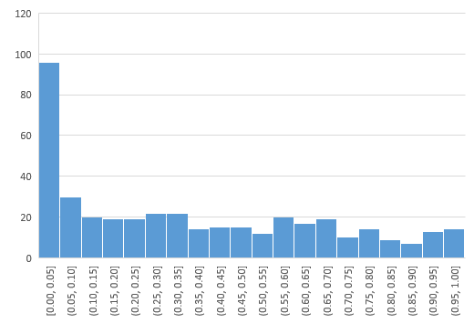
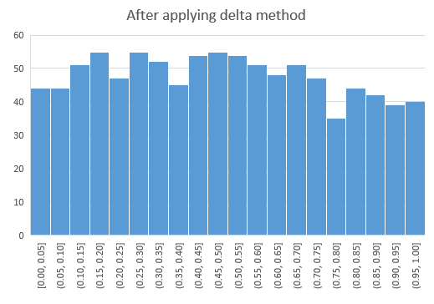
Example A/A test
P-value distribution for metrics in A/A tests should be uniform
When we got this for some Skype metrics, we had to correct things

Slide 11




MSN Experiment: Add More Infopane Slides
The infopane is the “hero” image at MSN, and it auto rotates between slides with manual option
Control: 12 slides
Treatment: 16 slides
Control was much better than treatment for engagement (clicks, page views)
Notes:
MSN shows 12 slides in the Infopane, whereas the competitors including Yahoo and AOL have order of magnitude more slides in theirs. So the hypothesis was that if we were to increase the number of slides in the Infopane we can get a better Today CTR as well as increase the Network PV/Clicks.

Slide 12
MSN Experiment: SRM
Except… there was a sample-ratio-mismatch with fewer users in treatment (49.8% instead of 50.0%)
Can anyone think of a reason?
User engagement increased so much for so many users, that the heaviest users were being classified as bots and removed
After fixing the issue, the SRM went away, and the treatment was much better

Slide 13
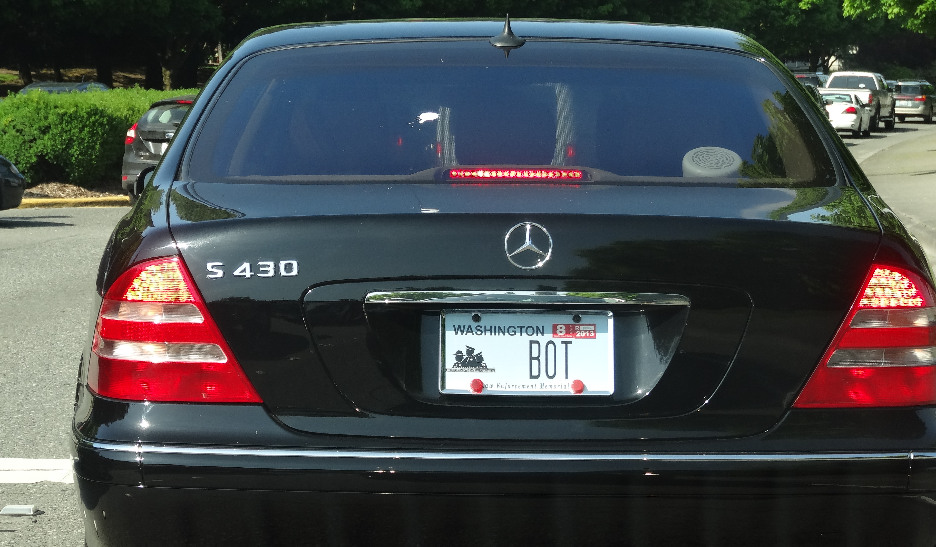

Pitfall 3: Failing to Validate Data Quality
Outliers create significant skew: enough to cause a false stat-sig result
Example:
An experiment treatment with 100,000 users on Amazon, where 2% convert with an average of $30. Total revenue = 100,000*2%*$30 = $60,000. A lift of 2% is $1,200
Sometimes (rarely) a “user” purchases double this amount, or around $2,500. That single user who falls into Control or Treatment is enough to significantly skew the result.
The discovery: libraries purchase books irregularly and order a lot each time
Solution: cap the attribute value of single users to the 99th percentile of the distribution
Example:
Bots at Bing sometimes issue many queries
Over 50% of Bing traffic is currently identified as non-human (bot) traffic!
Notes:
Negative times. Skype calls times of “days.”
Plot all univariate distributions
MSN added slides to slide show, caused more clicks, classified as bots. Reverse result. SRM

Slide 14

Instrumentation is Critical
Ad clickthrough rate(*) for Bing mobile appeared very different
All sorts of hypotheses developed about how Windows Phone users are better, then iOS, then Android
The delta is almost all due to instrumentation artifacts for clicks
iOS used redirects (slow but reliable)
Android used asynchronous click tracking (fast but lossy)
Windows Phone used asynchronous click tracking. Bug caused swipe actions to register as clicks
(*) y-values scaled by constant factor

Slide 15
The Best Data Scientists are Skeptics
The most common bias is to accept good results and investigate bad results. When something is too good to be true, remember Twyman
Twyman’s law Any figure that looks interesting or different is usually wrong
http://bit.ly/twymanLaw

Slide 16
Pitfall 4: Failing to Keep it Simple
With Offline experiments, many experiments are “one shot” so a whole science developed of how to make efficient use of a single large/complex experiment. For example, it’s very common offline to vary many factors at the same time (Multivariable experiments, fractional-factorial designs, etc)
In Software, new features tend to have bugs
Assume a new feature has 10% probability of having an egregious issue
If you combine seven such features in an experiment, then the probability of failure is 1-(0.9^7)=52% so would have to abort half the experiments
Examples
LinkedIn unified search attempted multiple changes that had to be isolated when things failed. See “Rule #6: Avoid Complex Designs: Iterate” at http://bit.ly/expRulesOfThumb
Multiple large changes at Bing failed because too many new things were attempted
Notes:
Don’t wait for all five features for an MVT to be done

Slide 17
The Risks of Simple
There are two major concerns we have heard about why “simple” is bad
Leads to incrementalism. We disagree. Few treatments does not equate to avoiding radical designs. Instead of doing an MVT with 6 factors, each with 3 values each thus creating 3^6 = 729 combinations, have a good designer come up with four radical designs.
Interactions.
We do run multivariable designs when we suspect strong interactions, but they are small (e.g., 3x3). Our observation is that interactions are relatively rare: hill-climbing single factors works well.
Because our experiments run concurrently, we are in effect running a full-factorial design. Every night we look at all pairs of experiments to look for interactions. With hundreds of experiments running “optimistically” (assuming no interaction), we find about 0-2 interactions per week and these are usually due to bugs, not because the features really interact

Slide 18
Pitfall 5: Failing to Look at Segments
It is easy to run experiments and look at the average treatment effect for “ship” or “no-ship” decision
Our most interesting insights have come from realizing that the treatment effect is different for different segments (heterogeneous treatment effects)
Examples
We had a bug in treatment that caused Internet Explorer 7 to hang. The number of users of IE7 is small, but the impact was so negative, it was enough to make the average treatment effect negative. The feature was positive for the other browsers
Date is a critical variable to look at. Weekend vs. Weekdays may be different. More common: a big delta day-over-day may indicate an interacting experiment or misconfiguration
We automatically highlight segments of interest to our experimenters
Notes:
Failing to look at segments

Slide 19
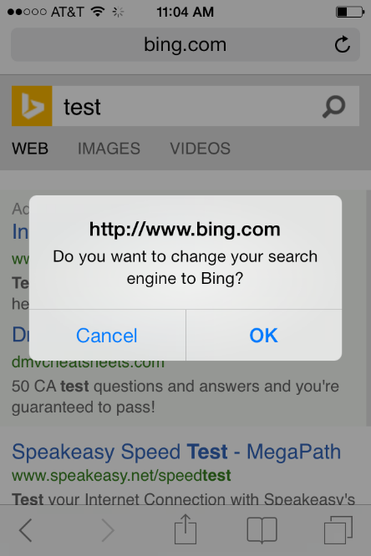
Example: New Bing Mobile Release
Major revamp of Bing UX for mobile happened (a few years back)
Scorecard shows a large drop in Sessions/User, our north star metric. Treatment was losing users relative to control. Terrible!
Segmenting by browser showed iOS issue
Segmenting by iOS showed iOS7 issue
Root cause: missing JavaScript resource that implemented a pop-up asking users if they want to change their search engine to Bing
Notes:
This is compelling for Driver testing – find segments of users.

Slide 20
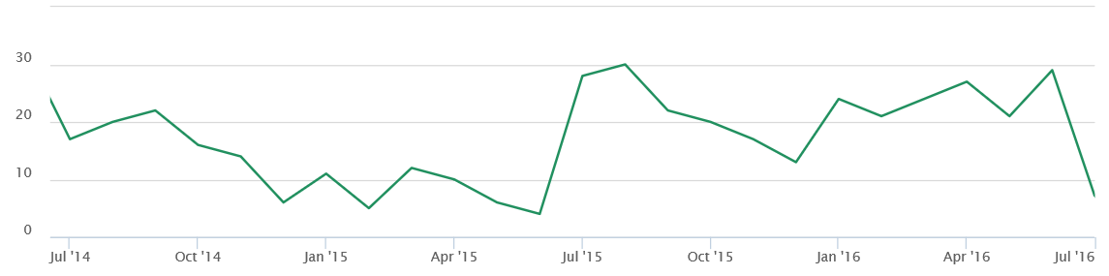
Pitfall 6: Failing to Evaluate Early
In theory, the experimenter does the power calculation and that determines the number of users required and hence the duration (we commonly run for 1 week or 2 weeks)
Early “peeking” is discouraged by the Statistics, as it leads to multiple-hypothesis testing issues
However, in the software world, early detection of bugs is critical, and the most critical time is at the start of an experiment
Graph of the number of experiments (per month) that are shutdown by our automated system. Critical!
Number of experiments/month that are shutdown due to metric degradation
Notes:
https://avocado/report_executions/8652608

Slide 21
Why Does Early Detection Work?
If we determined that we need to run an experiment for a week, how do NRT and ramp-up work well?
We are looking for egregious errors—big effects—at the start of experiments
The min sample size is quadratic in the effect we want to detect
Detecting 10% difference requires a small sample
Detecting 0.1% requires a population 100^2 = 10,000 times bigger

Slide 22
Summary: The Six Pitfalls
Failing to agree on an Overall Evaluation Criterion (OEC)
Failing to Validate the Experimentation System
Failing to Take Care of Data Quality
Failing to Keep it Simple
Failing to Look at Segments
Failing to Evaluate Early

